Slide 1
Player Sessionization
Improvement Effort, Summer 2017

Slide 2

How does sessionization work
And where does it fail
Notes:
We start off with simple machine telemetry. This data doesn’t contain information about the start and end of a player session. We must derive it. We have a processes of determining when play begins, and when, generally it ends, which we call microsessions. We also have an adhoc process where microsessions are linked together to form larger Player Sessions. We noticed it was failing during especially busy hours of the week, because bankrolls and session lengths were much too long. We decided we needed something better than an adhoc system. We needed a system that examined typical play and used machine learning to develop our method of connecting and breaking up player sessions.

Slide 3
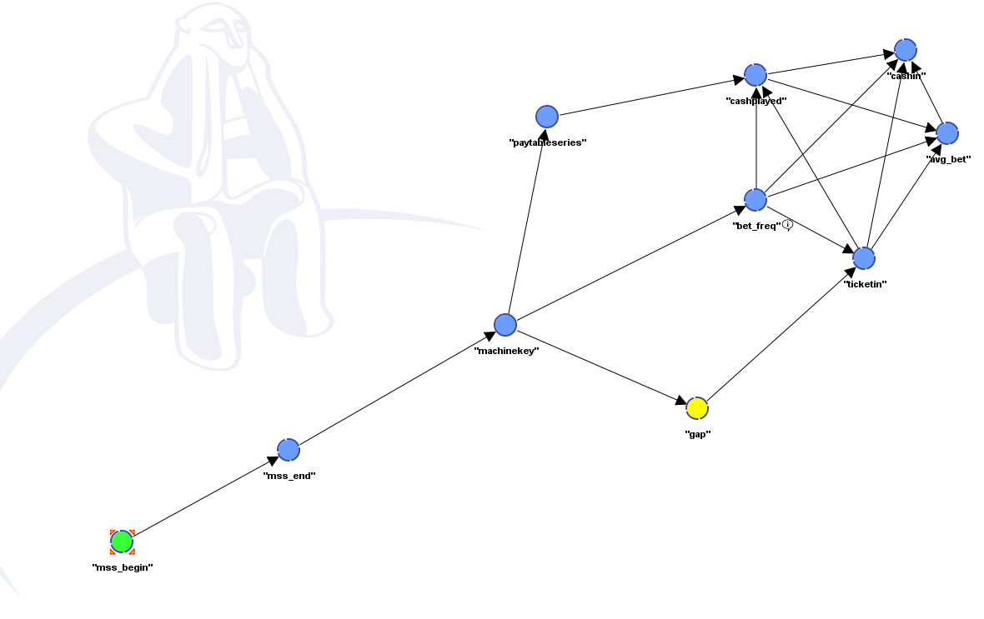
Bayesian Analysis
Notes:
Our first attempt was to gather data, and build a Bayesian network. It illustrated that the data had a very interesting DAG layout, but it also indicated that the gap time, which was our crucial metric, had weak joint probability with our chosen variables. We needed another way.

Slide 4





Player similarity
Notes:
What we needed was information that we didn’t have, but could derive using machine learning. Could the computer, by looking at the individual microsessions, tell if the current player was also the previous player? Even if the differences were very minor?

Slide 5

Cosine Similarity
Notes:
You may want to brush up on your linear algebra. Any vector, of any number of dimensions will have a cosine of between 0.0 to 1.0 with any other vector. You can create these vectors from any sort of data and compare them. The magnitude, or length, of the vector doesn’t matter as much as the direction. The closer they are pointing in the same direction the more similar they are. We applied this to player data and got some excellent results.

Slide 6
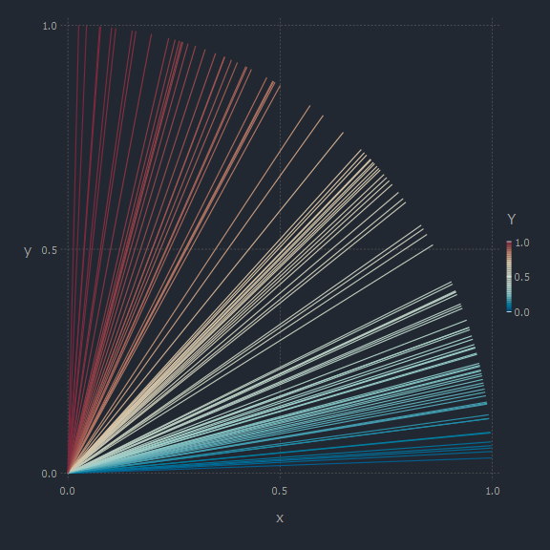
Player sessions
Player sessions and similarity compared to previous session on the same machine
Notes:
We needed to find a good distribution of similarities. If our choices of variables to put in our vectors were correct, we expected to see the gamut of results. This small sample set showed that we could use the method to determine if the current sessions was indeed played by the same person as the last session.

Slide 7
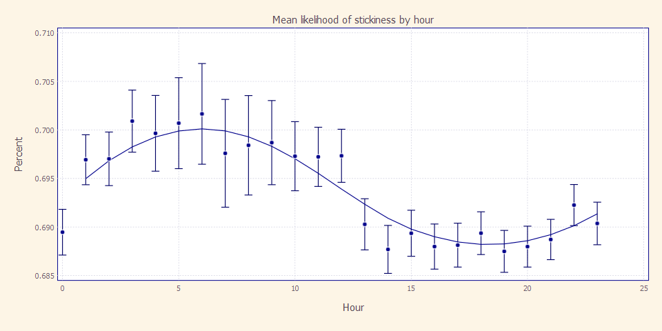
Was Time a factor?
Notes:
Yes indeed it was.

Slide 8
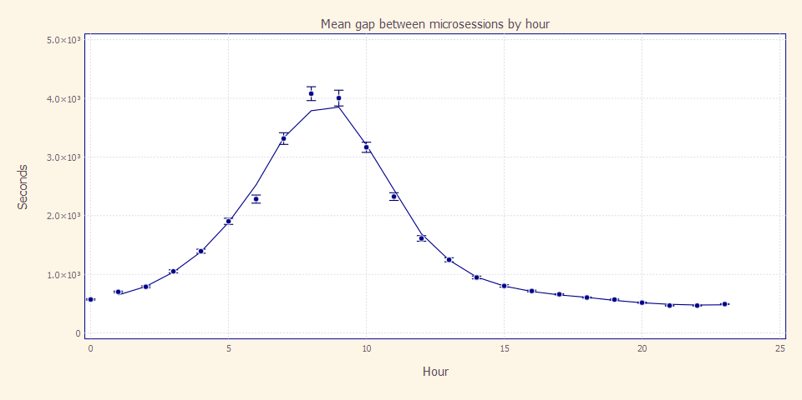
Are the gaps varied and follow a pattern?
Notes:
Again, yes.

Slide 9
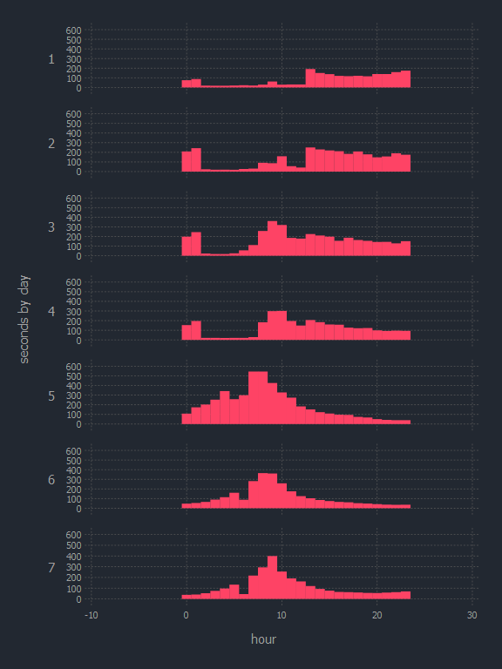
Do distribution change by day?
Notes:
Again, yes!

Slide 10
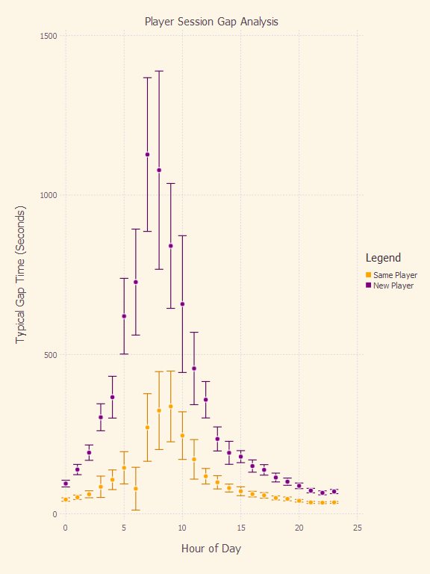
Final result
Good separation between continued and new sessions
Error does not overlap at 1 standard deviation
Error is reduced at peak times due to the large number of observations
The solution is simple to implement
Notes:
Here we see the final results. This is all Fridays in 2016 at Winstar. The remarkable thing is that machine learning, not knowing the gap times, was able to separate the cases, and when plotted, we see there is clearly a differentiation between the groups. Our solution will be to come up with data to do throttling on the threshold gap time used to separate player sessions. This will greatly enhance our understanding of play behavior, and give us confidence we are more accurate today than we were in the past.

